Slide 1
Project Powergetic
Enable Intelligent Power
Deloitte AI Data & Cloud Hackathon

Slide 2











WHO ARE WE?
Debraj Das
Mustufa Jan
Jayaprakash Kumar
Marc Lockhead
Wasim Boughattas
Mengqing Deng
Caitlin Everett
Michael Gesuale
Jonathon Nagassar
Rayan Roy
Jiakai Tang

Slide 3
TABLE OF CONTENTS
Introduce Problem
Electricity market current state
Value Proposition
Model Breakdown
Architecture
Demo
Monetization / Production
Q&A (add appendix)

Slide 4
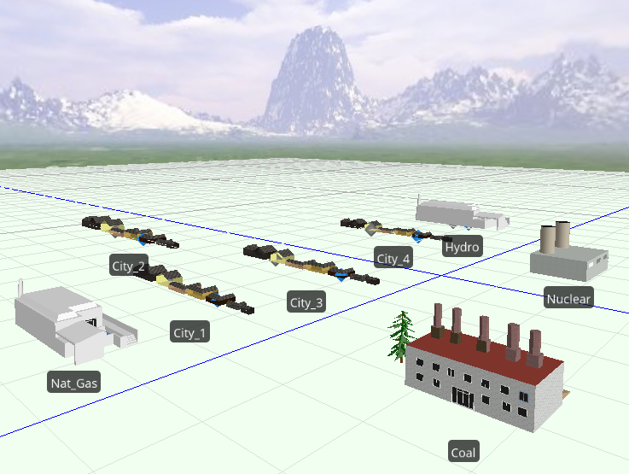
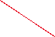
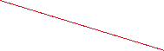
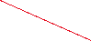

Motivation:
Require lots of power
Unplanned surge = Operational outage
Need to find power
Demand Surge!
Notes:
Power is crucial to

Slide 5

Additional Capacity
Notes:
Power is crucial to

Slide 6
The Intelligent Solution
By analyzing past data, we can model the demand of power for by region we are trying to mitigate the economic hit incurred by having to purchase power from other areas of the grid by pre purchasing appropriate amounts of power.
We have developed models that have the ability to intelligently recommend power purchases to both reduce incurred costs to and minimize carbon footprint in market in these 5 Norwegian cities.
Tromsø
Trondheim
Molde
Bergen
Kristiansand
Oslo

Slide 7
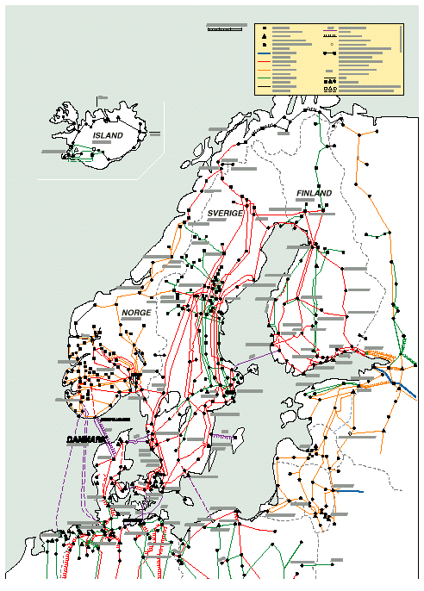
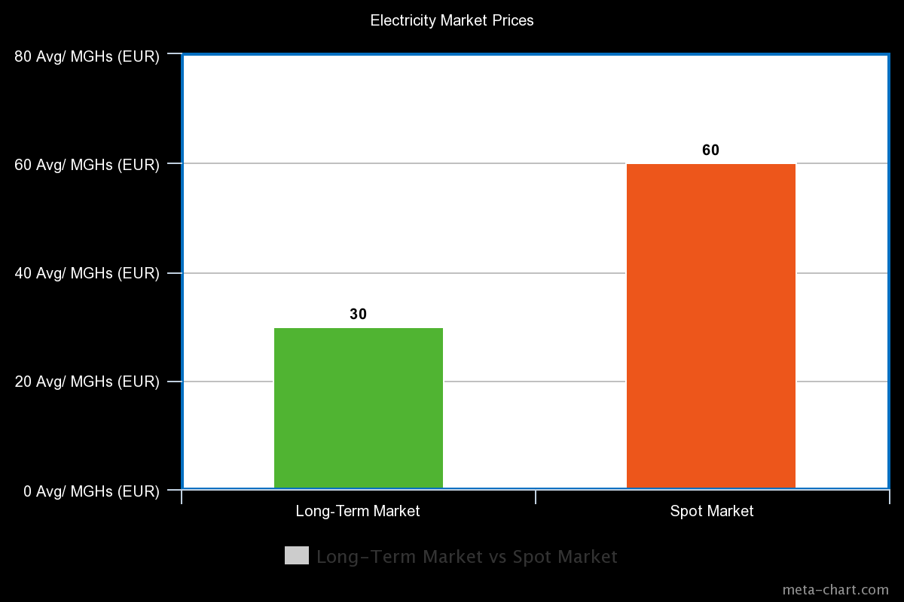
Electricity Market Current State State
Tromsø
Power Lines in Norway
In the event of a power outage, how to optimize the cost and energy footprint?
Trondheim
Molde
Bergen
Kristiansund
Oslo

Slide 8
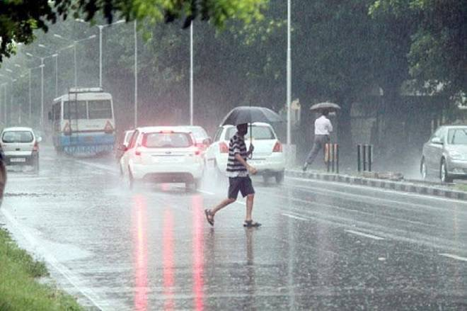


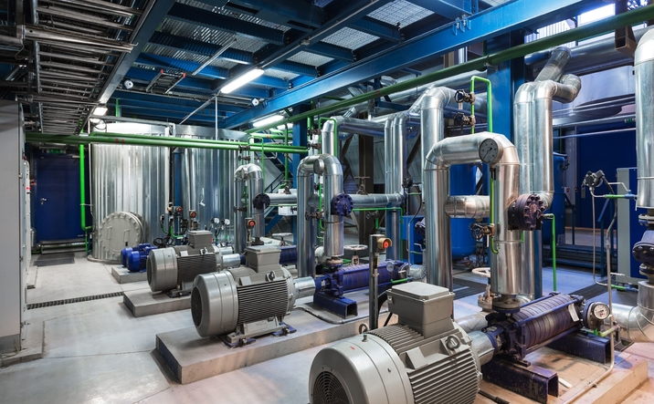
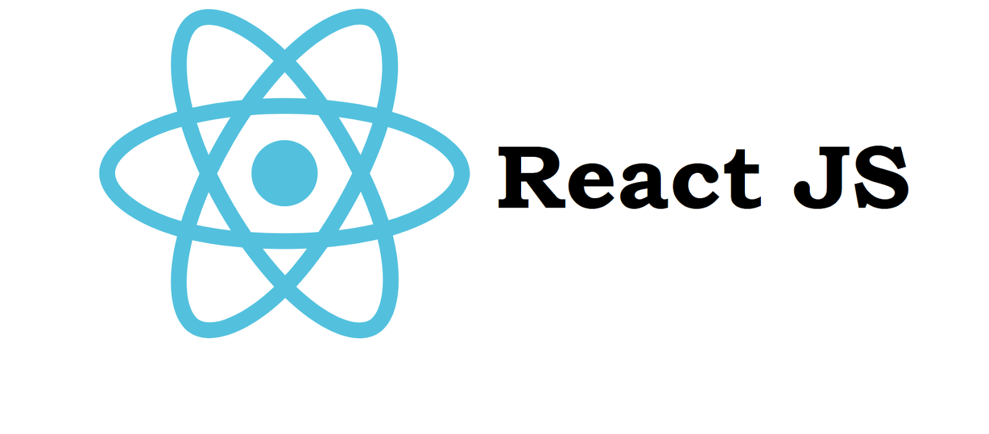

Value Proposition
City of Winnipeg
Technology

Slide 9



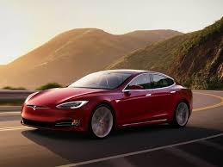


Valentine’s Day Dinner Plans

Slide 10
Norway’s top industries (bonus: largest electricity consumers!)

Slide 11



Planned buying vs

Slide 12
Model implementation strategy
One model per Norwegian City
Electricity markets are volatile!
Market High
Market Low Classical EOD Close prices
Volume
Better Way

Slide 13
Model Breakdown
Model 1: Pre-buying, AKA Reserving
Realized
Model 2:
Coming soon

Slide 14
Architecture
Azure/AWS/GCP
Docker
Docker
UI
REST
Model
ReactJS
IgniteUI; Bootstrap; CanvasJS
Flask
XG Boost
We are NOT bound to one cloud
We are DOCKERIZED: we are on EVERY cloud
Swagger
Testing UI & REST Service
Notes:
3 Tiers (UI/UX; REST Microservice; Model)
Docker (we are not bound to any cloud: we are on every cloud)
No licensing fees to 3rd parties
Horizontal scale up/out (think kubernetes)
Stateless/all our functions are idempotent
Technical Organization Structure
Software: Git; MS Project/Gantt Chart
Hardware: Intel Xeon 40 Cores; 192 GBs RAM
XG Boost; Python 3.8; Flask; Swagger; ReactJS (IgniteUI; Bootstrap; CanvasJS)

Slide 15

DEMO

Slide 16
FINANCIALS
Cost +
Subscription
Volume
Export to member firms
On-going consumption prediction needs
Periodical consumption prediction needs

Slide 17
PRODUCTION
Fully Functional Assets*:
Enterprise integration layer: REST Microservice; Cloud-ready (already dockerized)
Electricity Consumption Capacity ML Model
UI/UX
Work In Progress Assets*:
Model refinement (commercial data required, hyper parameter tuning)
Price Hedging Model (spot real-time market)
5 Developers
2 Business Solution Architects
1 Project Manager
8 Weeks
Pre-Accelerator
Accelerator
Asset
Product
5 Developers
2 Weeks
2 Developers
2 Product Managers
1 Project Manager
4 Weeks
*All assets are version controlled on Git
Total Cost = Resources x Time Needed
Notes:
Indicate resources and time needed from one stage to the next stage

Slide 18
Thank You!
We are opening the floor for questions!

Slide 19
Appendix

Slide 20
Appendix A – Definition of Outage
Physical outage: when physical operating failures prevent power distribution
Operational outage: when sufficient power has not been reserved apriori requiring spot-market purchase

Slide 21
Appendix B – Definition of Production Stages
Accelerator: can be used by dev team but raw and needs adjustments
Asset: still by dev team but quite refined already and more versatile, documented and fully tested
Product: can be almost made available to client, only configuration required

